Slide 1





SWE3028-Fall-2024
Capstone Design Project
NLP-based
Psychological Diagnostic Diary
Weekly Progress Meeting (3)
런닝머신 팀(TEAM C)
김나영 김예담 박준현 방기호

Slide 2


CONTENTS
01
Recap
02
Progress
1. UX/UI 2. Front-end 3. AI 4. Back-end
03
Challenging Problem
Capstone Design Project

Slide 3










01. Recap
Week 2-3 | Week 4-5 | Week 6-7 | Week 8-9 | Week 10-11 | Week 12-13 | Week 14-15
Topic Ideation
Data Collection
AI Model Design
Data PreProcessing
Model & Algorithm Implementation
UX/UI Design & Implementation
Beta Service & FeedBack
Capstone Design Project

Slide 4
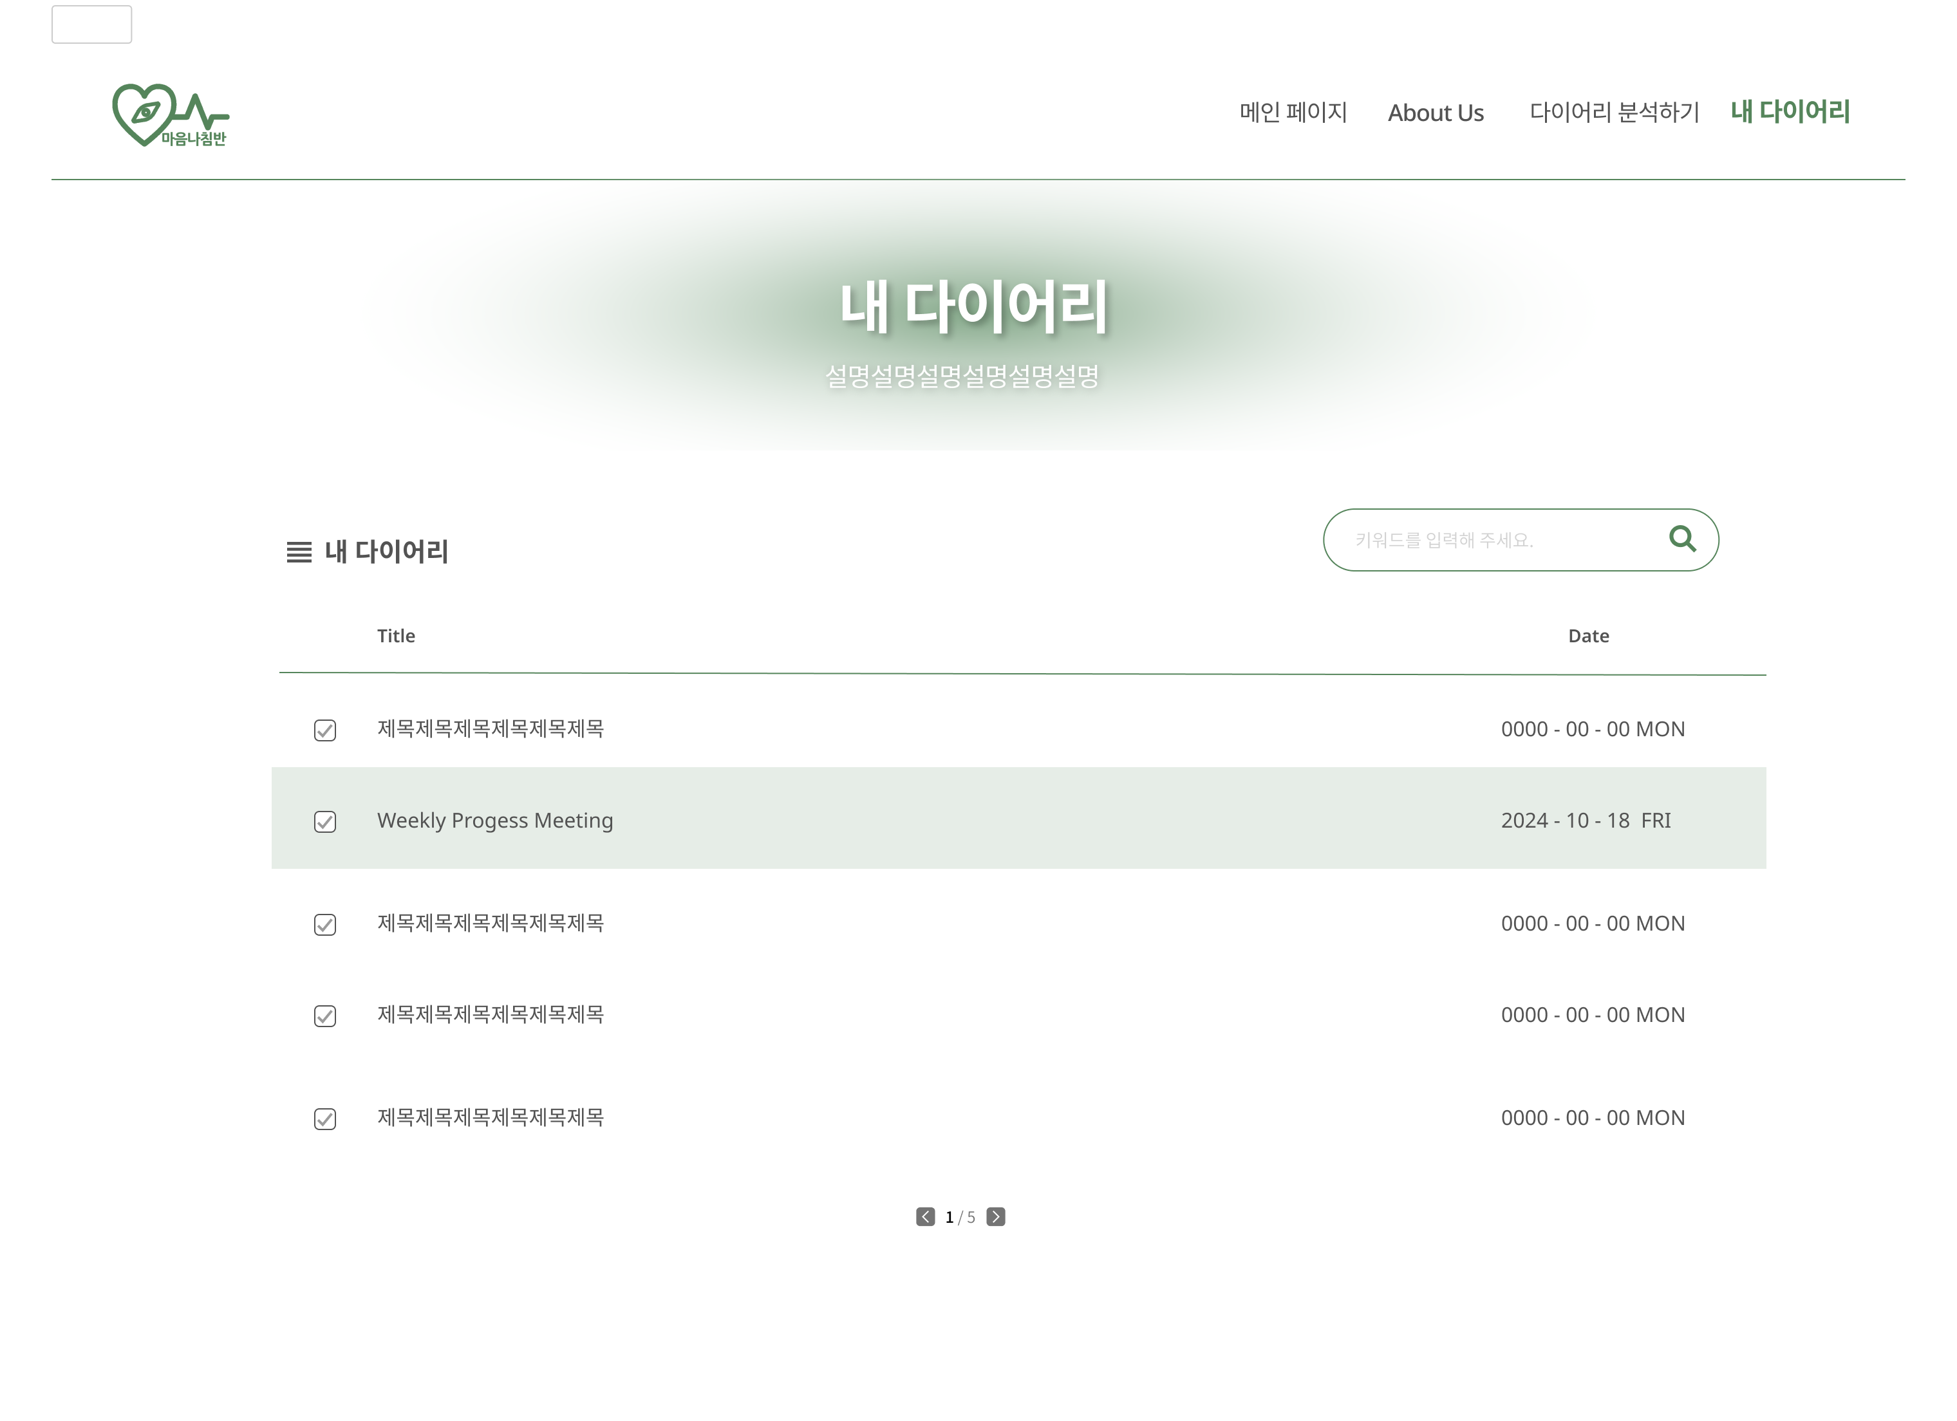
02. Progress – [UX/UI]
Page Design for ‘내 다이어리(My Page)’
Capstone Design Project

Slide 5
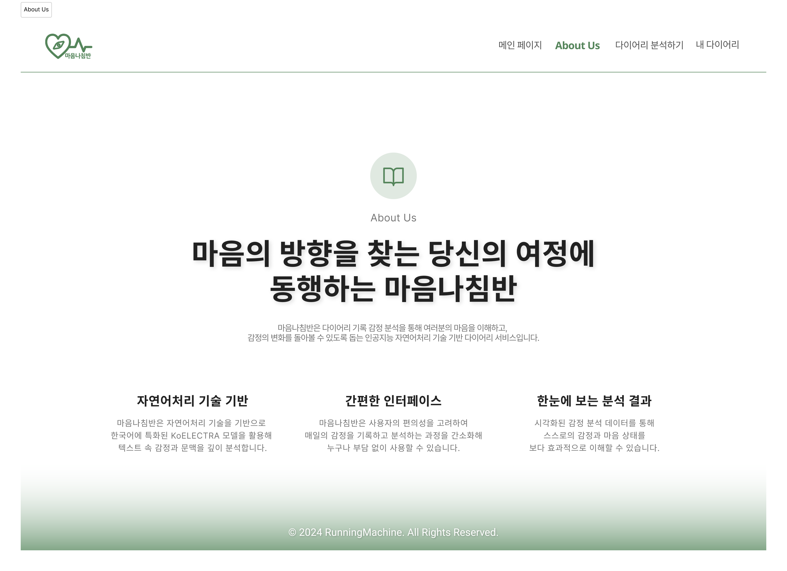
02. Progress – [UX/UI]
Page Design for ‘About Us’
Capstone Design Project

Slide 6
02. Progress – [AI] Architecture
raw data
mask insertion
fill mask using KoELECTRA
augmented data
fine-tuning using KoBERT
Capstone Design Project

Slide 7



02. Progress – [AI] Data Augmentation
< KoELECTRA >
A natural language model that learns ELECTRA with 34GB of Korean text
Efficient learning structure
Korean-specialized
Capstone Design Project

Slide 8
02. Progress – [AI] Evaluation Metrics
 | Test Acc | F1-score | Precision | Recall | Cosine Similarity
Entire dataset | 0.840 | 0.871 | 0.861 | 0.863 | -
Only 8 labels | 0.876 | 0.855 | 0.856 | 0.856 | 0.951
Only Insertion | 0.867 | 0.881 | 0.864 | 0.885 | 0.973
Both | 0.865 | 0.864 | 0.864 | 0.865 | 0.964
Capstone Design Project

Slide 9
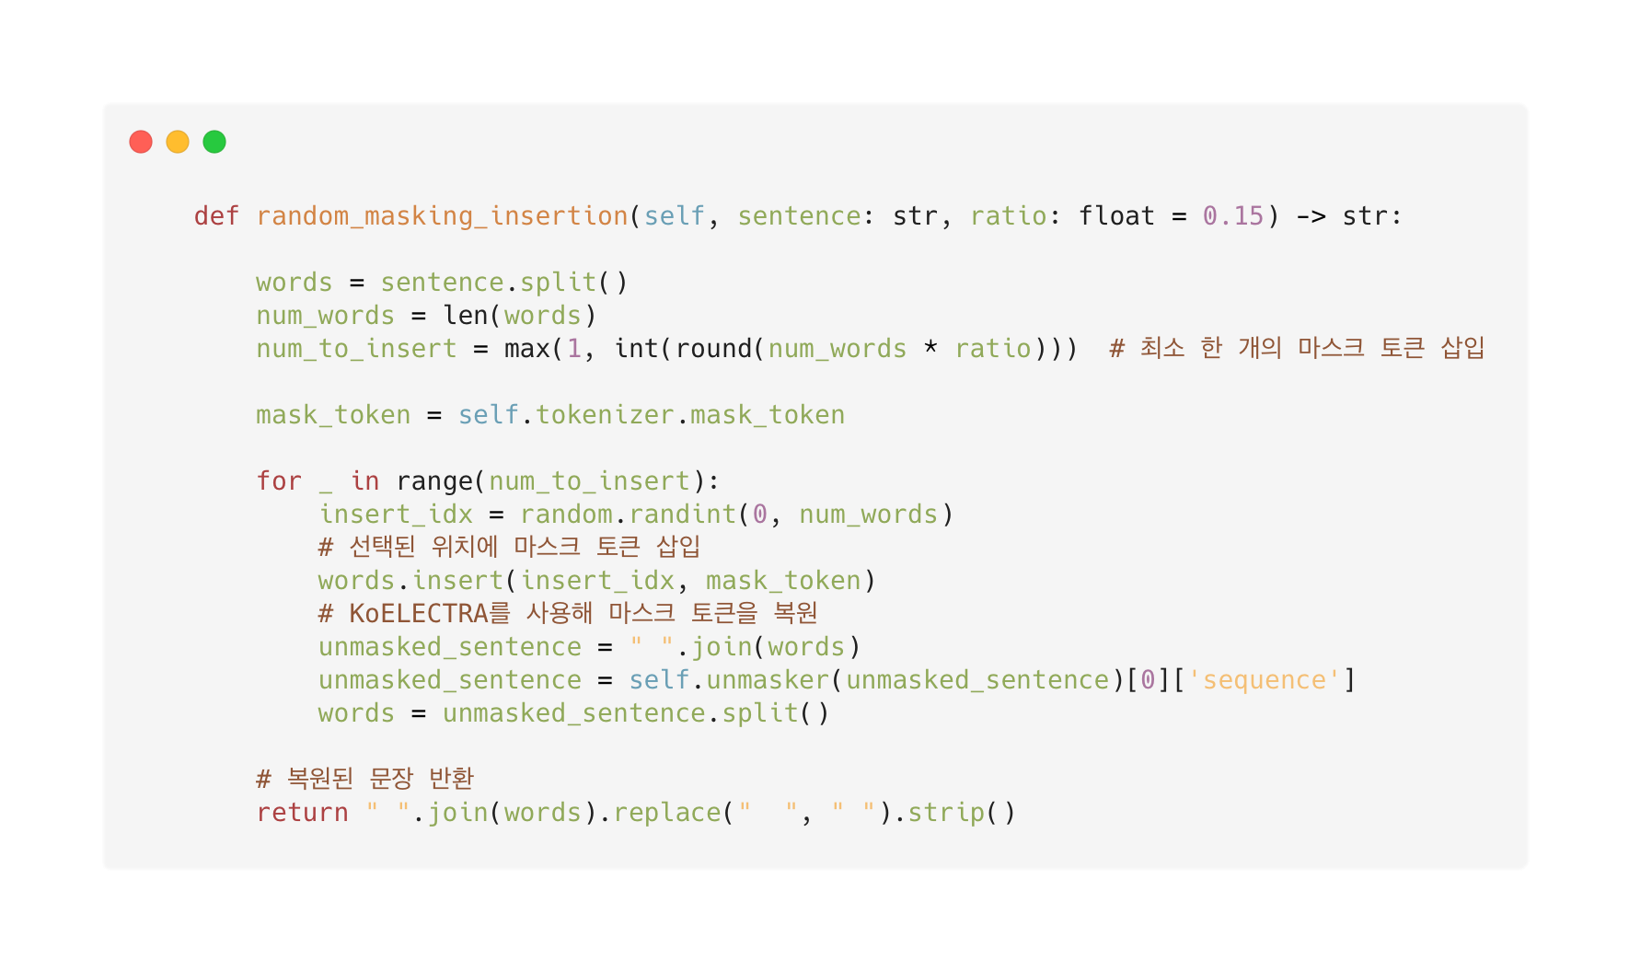
02. Progress - [AI] Data Augmentation
Capstone Design Project

Slide 10

02. Progress – [AI] Data Augmentation
Random Masking Insertion
그런데 완전히 죽기에는 3층이 너무 낮았던 거죠.
7
max(1, round(7 x 0.15)) = 1
Randomly
그런데 완전히 죽기에는 3층이 너무 낮았던 [MASK] 거죠.
KoELECTRA's fill-mask pipeline
그런데 완전히 죽기에는 3층이 너무 낮았던 그런 거죠.
Capstone Design Project

Slide 11

02. Progress – [AI] Data Augmentation
nervous | 3049
insomnia | 2317
sadness | 2150
1. Augment the entire dataset
...
loneliness | 956
hopeless | 887
suicidal | 727
appetite↑ | 540
concentration↓ | 458
confidence↓ | 445
loss | 439
emotion control↓ | 389
2. Augment only for the 8 labels
with less than 1,000 utterances
Capstone Design Project

Slide 12
02. Progress – [AI] Evaluation Metrics
 | Test Acc | F1-score | Precision | Recall
Entire dataset | 0.868 | 0.868 | 0.868 | 0.868
Only 8 labels | 0.876 | 0.855 | 0.856 | 0.856
Capstone Design Project

Slide 13
02. Progress - [AI] Hyperparameter Tuning
Learning rate: [5e-5, 3e-5]
Batch size: [16, 32]
Warmup ratio: [0.1, 0.2]
Dropout rate: 0.1
Epochs: 10
Max grad norm: 1
Log interval: 200
Max length: 512
Learning rate: 5e-5
Batch size: 16
Warmup ratio: 0.2
Dropout rate: 0.1
Epochs: 10
Max grad norm: 1
Log interval: 200
Max length: 512
Capstone Design Project

Slide 14
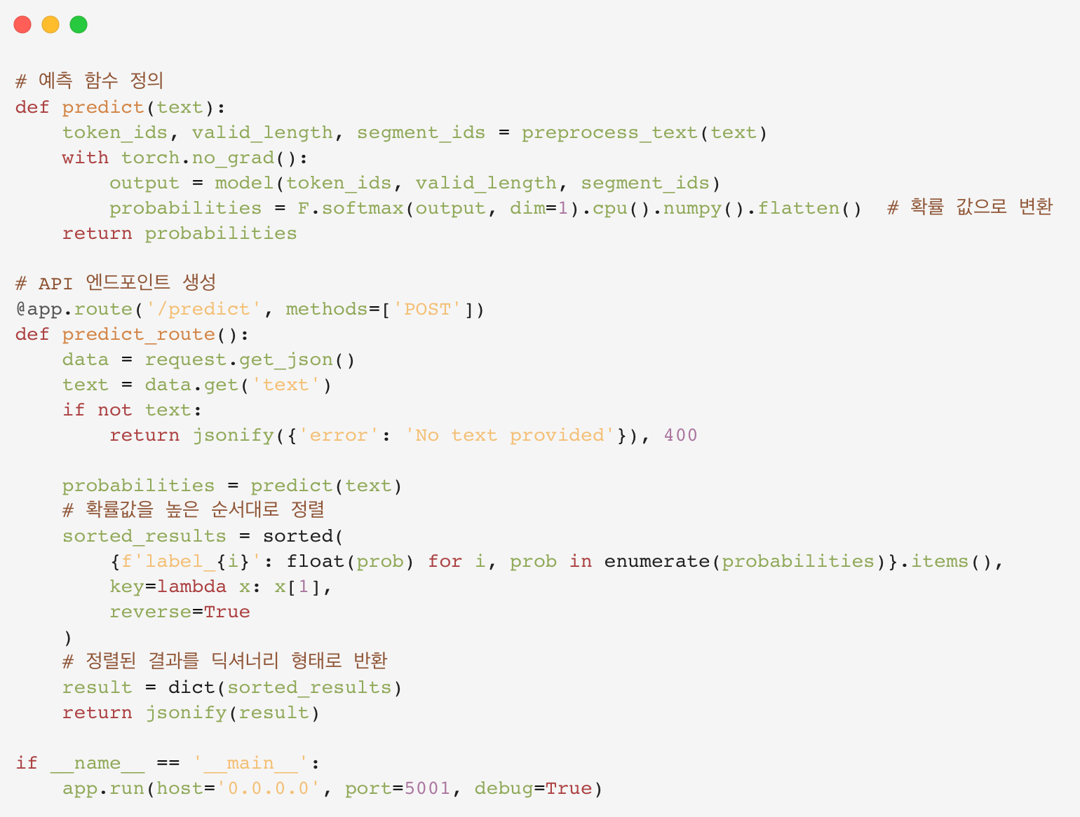

03. Progress - [AI] Model Serving
Capstone Design Project

Slide 15
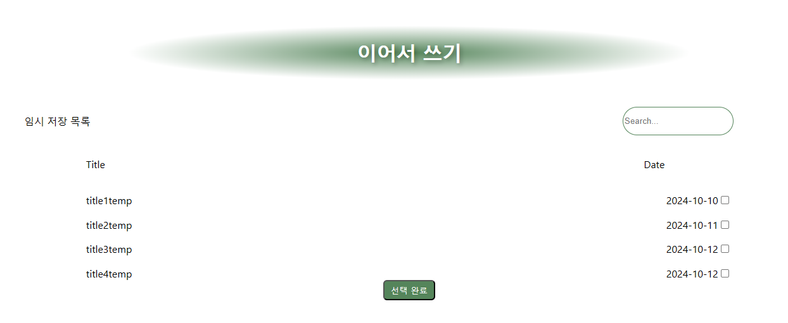
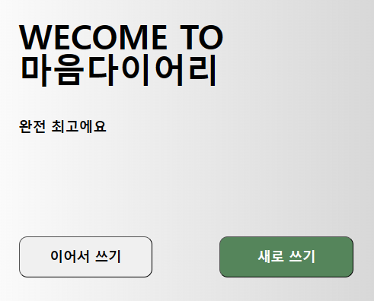
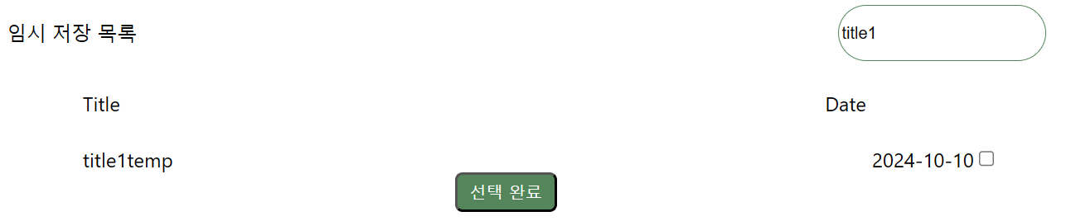
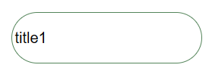
02. Progress - Frontend
Capstone Design Project
Notes:
We have completed the 'Continue Writing' page. The page can be accessed through the button in the main page.
On this page, users can easily view their temporarily saved writings.
Additionally, we implemented a search feature that allows users to find specific entries by searching for the title.
This makes managing saved drafts much more efficient for users.

Slide 16
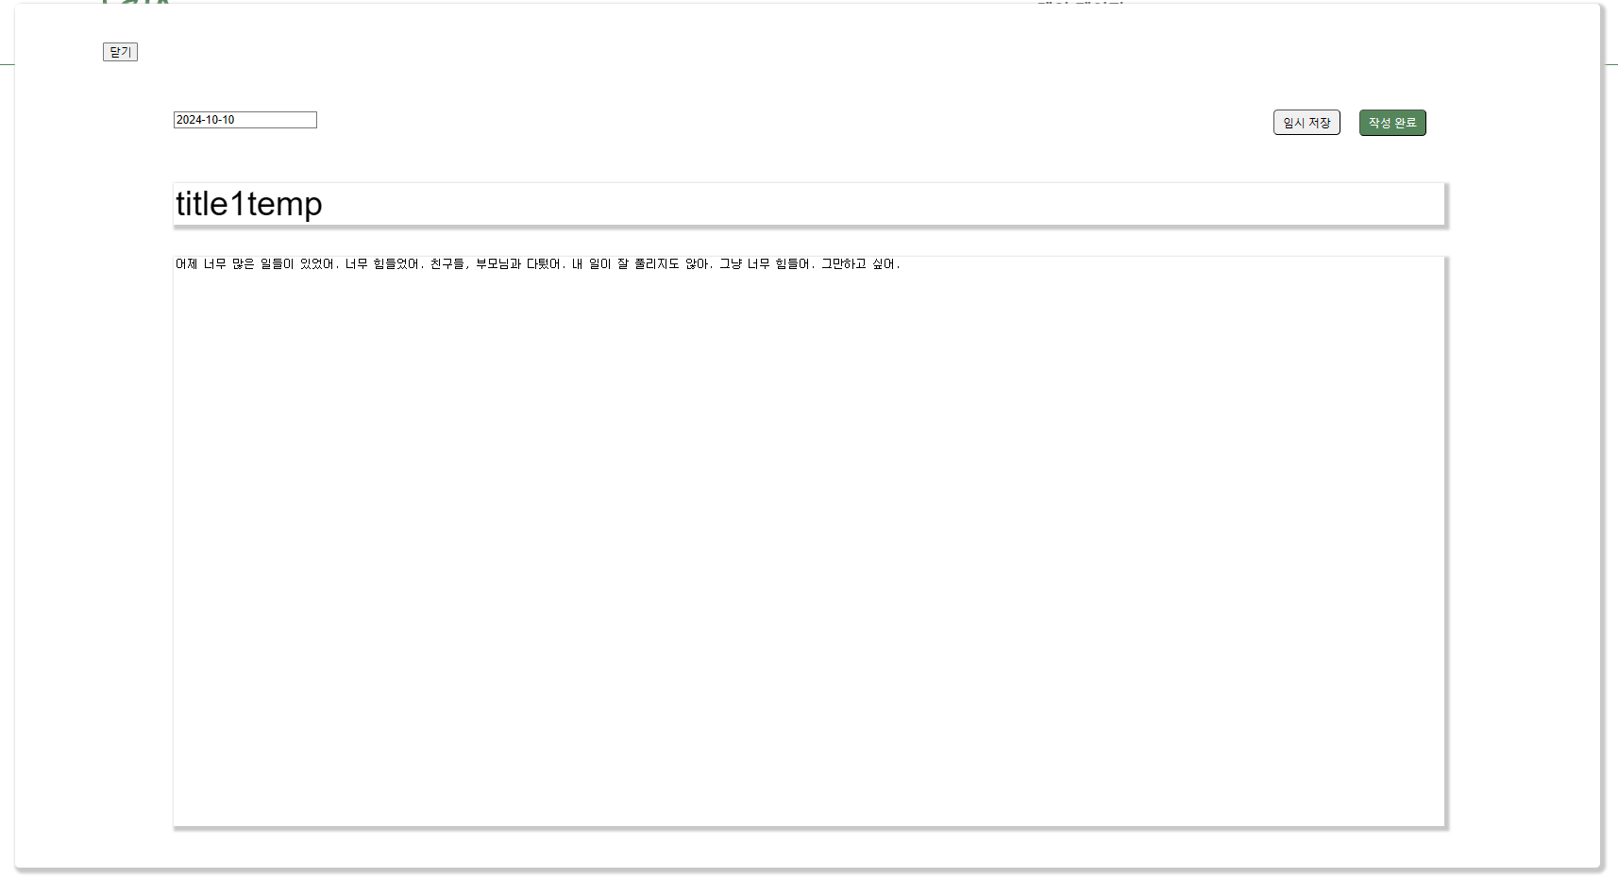
02. Progress - Frontend
Capstone Design Project
Notes:
Now, users can simply select the checkbox for the entry they want to continue and click 'Complete Selection'.
This will load the previous date, title, and content of the entry.
The page also supports saving drafts and permanent saving as before.
This makes the continuation process much more intuitive and convenient for users.

Slide 17
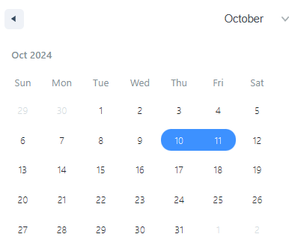
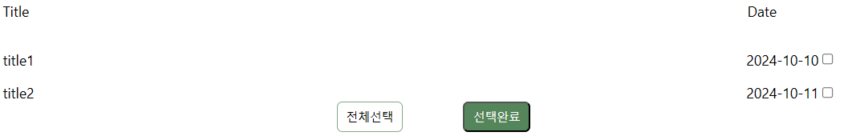
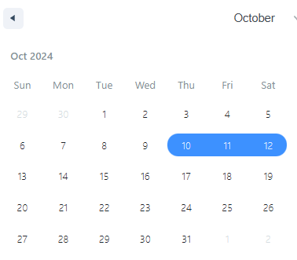
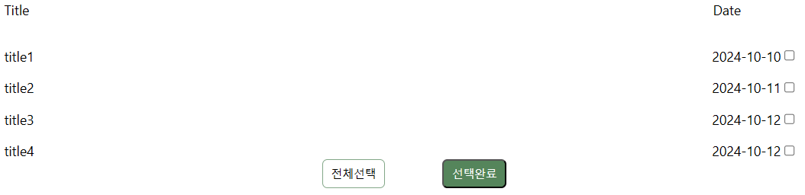
02. Progress - Frontend
Notes:
The 'Analysis Page' now uses a DateRangePicker to filter entries within a specific date range.
For example, the displayed data includes 2 entries written between October 10 and 11,
and 4 entries written between October 10 and 12.
This feature allows users to analyze entries written within the desired time frame.

Slide 18
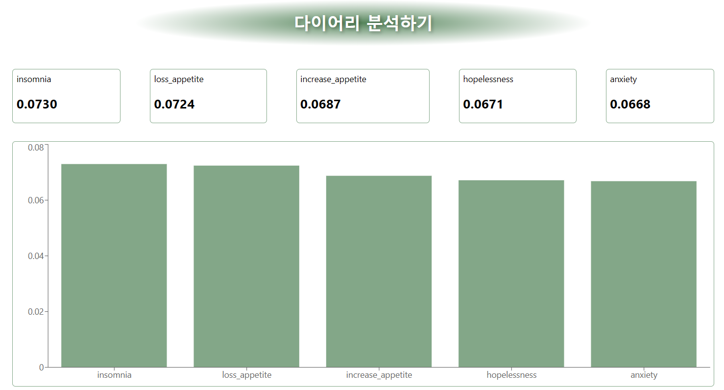
02. Progress - Frontend
Notes:
Previously, we received feedback that too many graphs made the screen cluttered and hard to interpret.
To address this, we adjusted the view to show only the Top 5 items as a bar chart.
Additionally, we added a separate box to display exact numbers for better clarity.
This makes it much easier for users to understand the data.

Slide 19
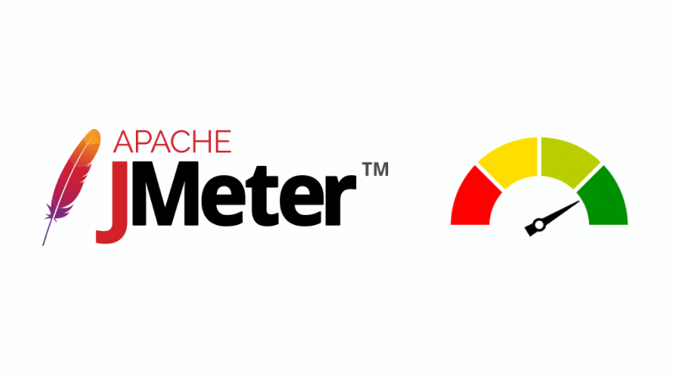
02. Progress – [Back] Performance Test
Capstone Design Project
Notes:
Let me share the progress we’ve made on the backend development so far. Both data normalization and code implementation have been completed, leading us to the testing phase. First, we conducted functional testing by simulating various scenarios aligned with the product’s use cases. This involved verifying whether incorrect data was being stored in the database and checking the server logs for any errors or irregularities.
After successfully completing functional testing, we decided to move on to non-functional test to evaluate its ability to handle real-world traffic scenarios. Among the various performance testing tools available, We selected JMeter due to its flexibility, robust features, and wide adoption in the industry. After applying a predefined level of traffic to the AG server, We observed that the system was delivering an unexpectedly low TPS (Transactions Per Second), which immediately indicated a potential performance bottleneck.

Slide 20
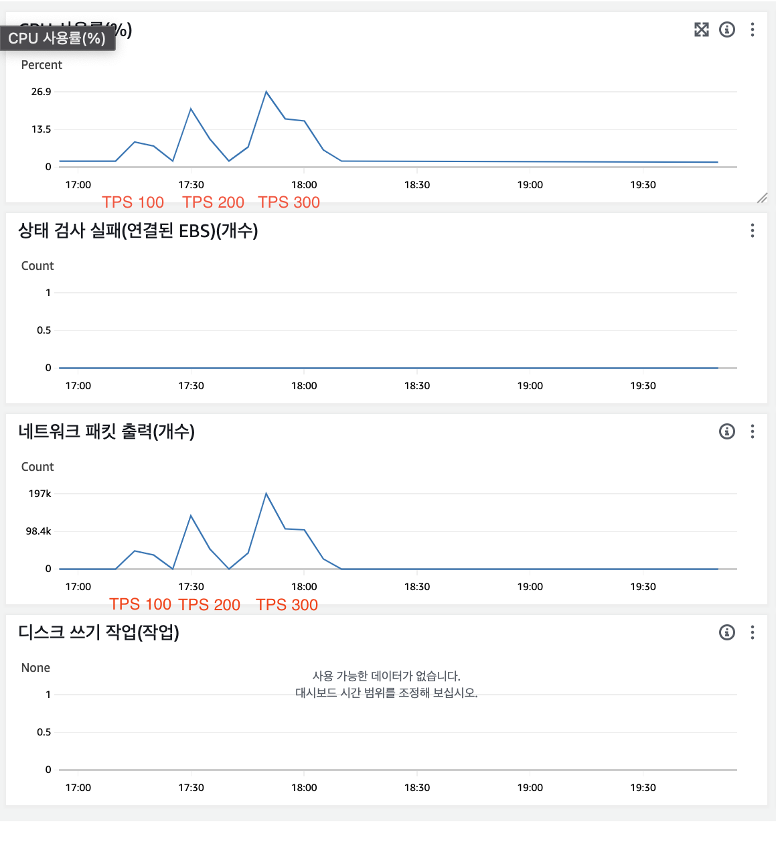
02. Progress – [Back] Performance Test
CPU 사용률
WHY?
Capstone Design Project
Notes:
To pinpoint the root cause of this issue, We leveraged AWS CloudWatch to monitor the performance metrics and overall health of the server instances. As depicted in the figure, the CPU utilization showed a sharp and excessive increase whenever the server was subjected to load. Given that the instance specifications were designed to handle the anticipated traffic comfortably, I concluded that the bottleneck might not stem from the servers themselves but rather from another component, likely the database

Slide 21
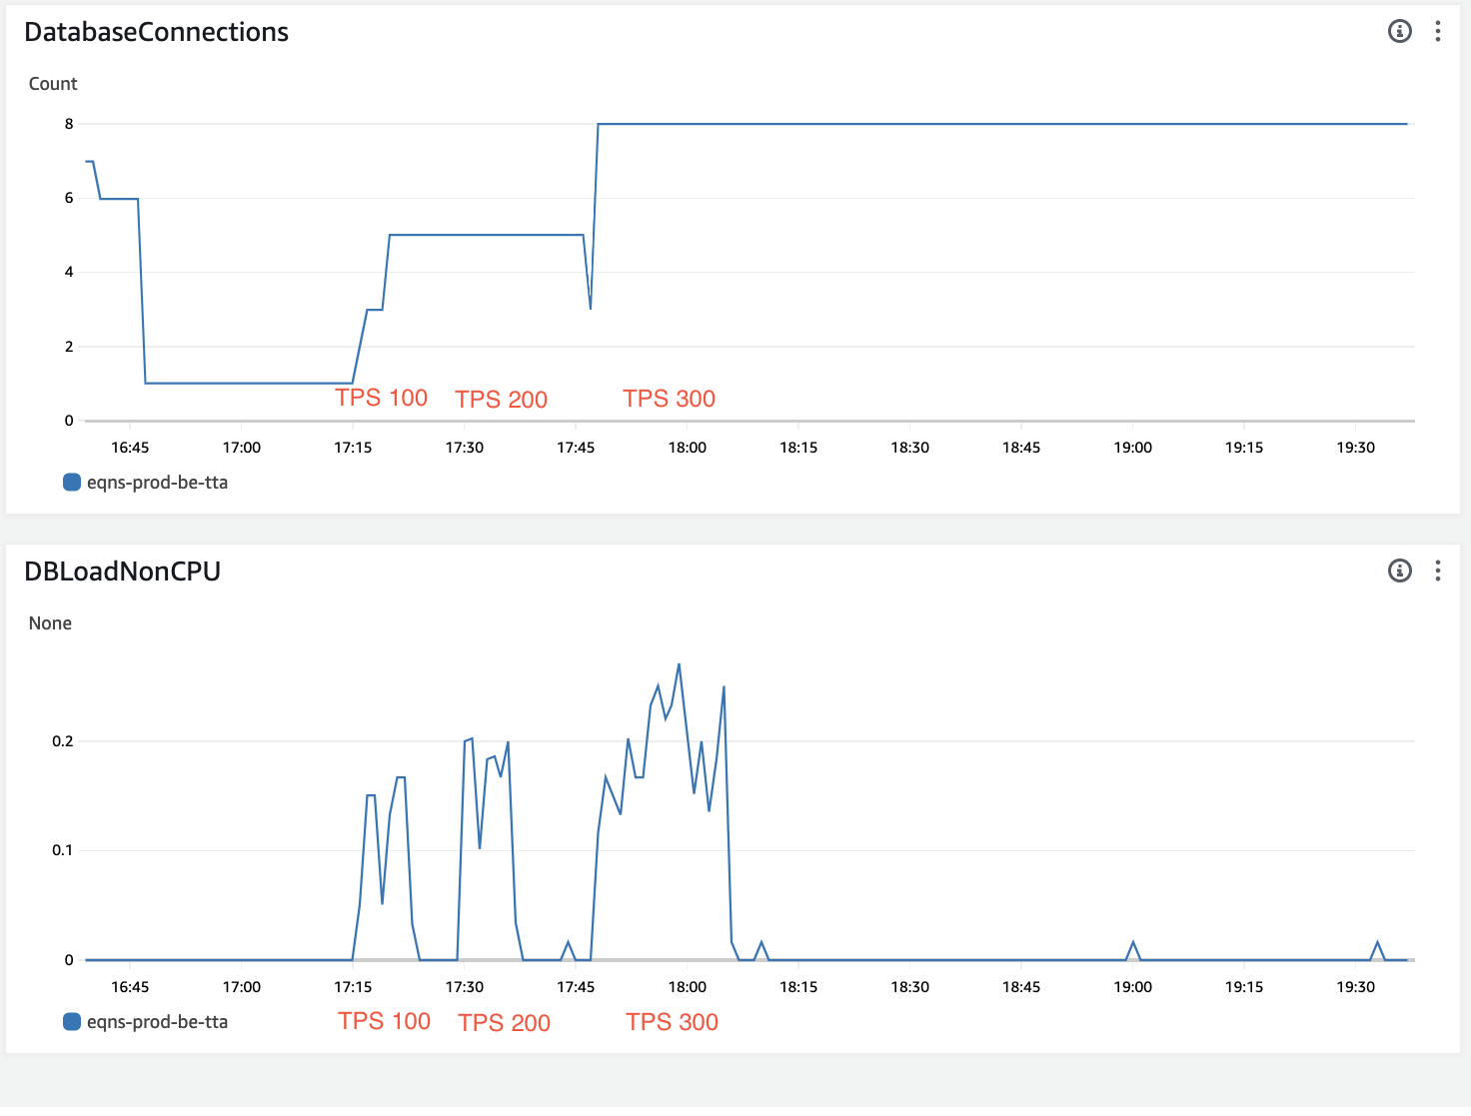
02. Progress – [Back] Performance Test
Capstone Design Project
Notes:
To confirm this hypothesis, We analyzed the database metrics using CloudWatch, and the results are shown in the figure. One critical observation was the DatabaseConnections metric, which remained capped at a maximum value of 8, despite the increasing load. This abnormal behavior strongly suggested that the issue was caused by a limitation in the number of available database connections. After identifying this as the root cause, We implemented the necessary modifications to resolve the limitation. As a result, the TPS has improved significantly and now operates at a normal and expected level.

Slide 22

03. Challenges - Frontend
Capstone Design Project
Notes:
The challenge in frontend is the continuation of a bug we reported earlier.
Although data from the backend was successfully delivered,
the frontend required a manual refresh for the graph to display the data correctly.
After extensive testing, we identified the issue:
Page transitions occurred before the data was fully loaded.
As a temporary solution, we implemented a wait function to delay the page transition until the data was ready.
This resolved the refresh issue, but if data loading takes longer, the bug might reappear.
Further work is required to address this issue fundamentally.

Slide 23


Q & A
NLP-based Psychological Diagnostic Diary
Capstone Design Project

